Slide 1

Chapter 2
Introduction to Agent-Based Modelling
Notes:
In this Chapter we introduce the key concepts behind agent-based modelling. What is an agent, and what are rules? These are discussed along with a consideration of the main advantages and disadvantages for simulating spatial systems. A range of established applications are presented to give a flavour of how agent-based models can be successfully applied. The overarching aim of this chapter is to give the reader an understanding of what an agent-based model is. This knowledge will be built upon in subsequent chapters.

Slide 2
Learning Objectives
The overarching aim of this chapter is to give the reader an understanding of what an agent-based model is.
Set the scene for the following chapters which go into more details about agent-based modeling.
Introduce key concepts behind agent-based models
E.g., What is an agent, and what are rules?
Outline the main advantages and disadvantages for simulating spatial systems.
Demonstrate how agent-based models can be successfully applied to a range applications.

Slide 3
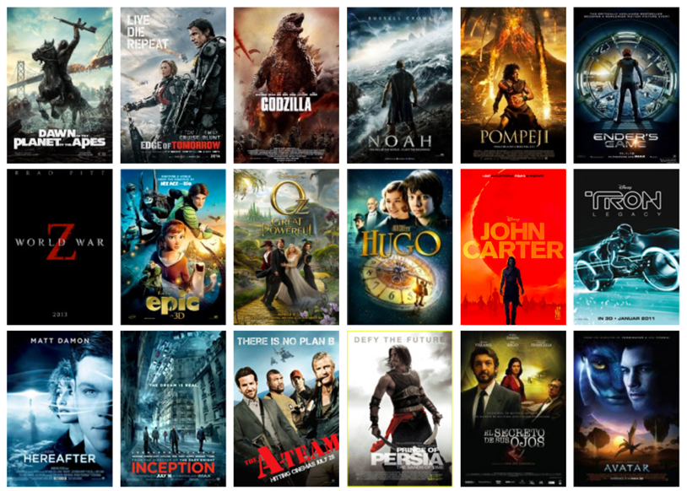
Introduction
Agent-based models are beginning to appear in many different aspects of our lives.
For example, Massive has used agent-based modelling in a number of films.
Agent-based modelling allows individuals with their own set of unique characteristics and rules of behavior to be created, and see how patterns emerge from the bottom up.
Source: http://www.massivesoftware.com/

Slide 4
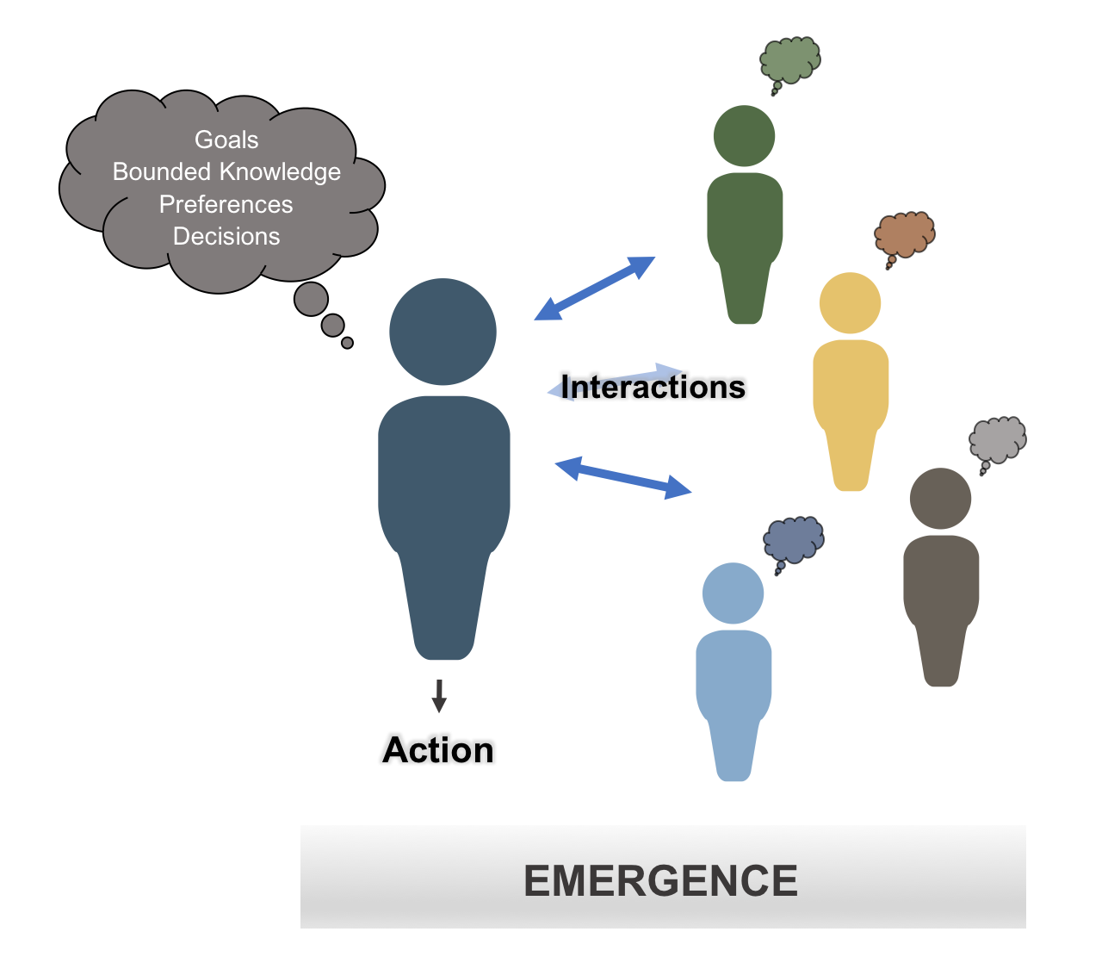
What is an Agent?
Agents are:
Autonomous
Heterogenous
Active
Goal directed
Reactive
Interactive / communicative
Adapt and learn
Figure 2.2: Schematic illustrating some of the main components of an agent.

Slide 5
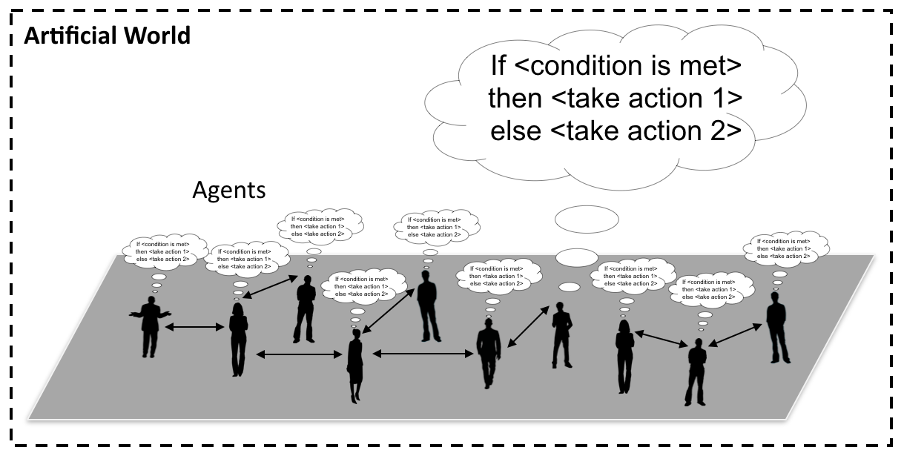
Agent Rules and Artificial Worlds
Rules are a set of commands that are assigned to each agent to guide their behavior and decision-making.
Rules are typically based around if–then–else statements.
These rules are applied to agents within artificial worlds
Figure 2.3: Conceptualization of an agent-based model where people are connected to each other and take actions when a specific condition is met.

Slide 6
Advantages of Agent-based Modelling
Increases in both computational power and data have changed the way researchers think about geographical systems.
Move from aggregate to disaggregate models
From static to dynamic models
Agent-based models allows us to focus on processes that generate geographical patterns.
Focuses on individuals (and their decisions)
Agent-based models can be defined within any application area, for example a building, a city, or a road network.

Slide 7
Limitations of Agent-based Modelling
No template or universally accepted way to design and build agent-based models.
Issues of reproducibility
Some criticize agent-based models as being data hungry and such data does not exist.
Issues of calibration and validation
These issue will be revisited in later chapters along with guidelines on how they can be overcome.

Slide 8
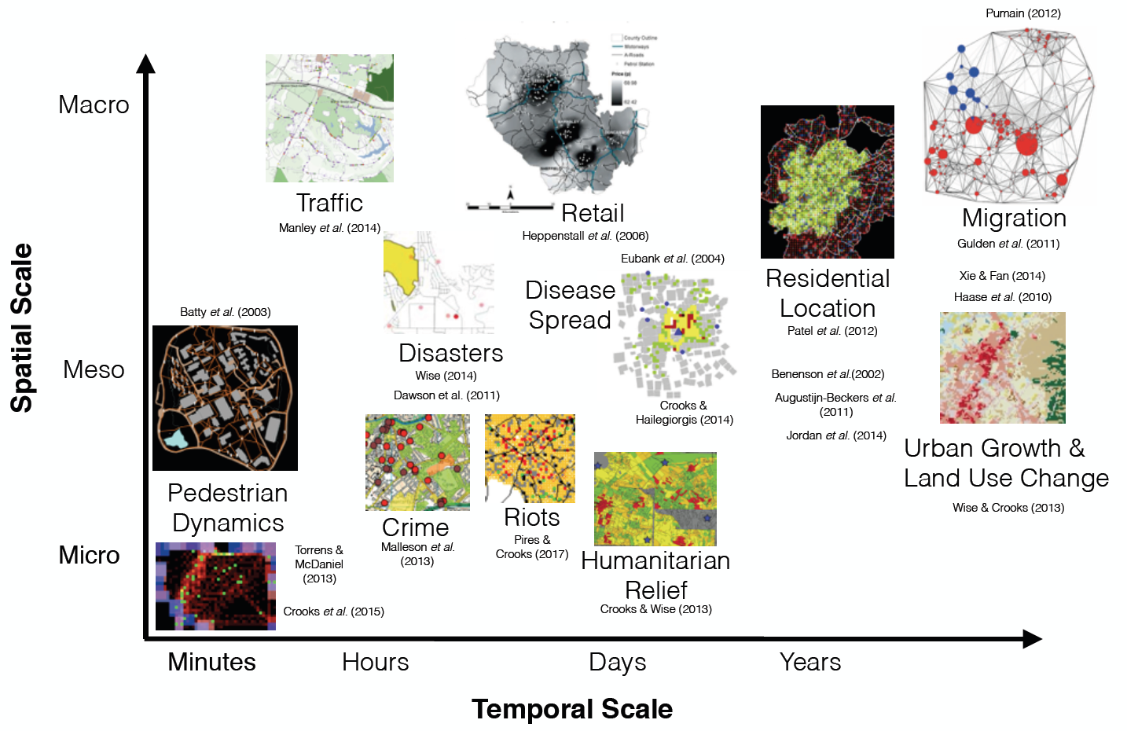
A Gallery of Applications
Agent-based modelling is being used in a diverse set of areas ranging from archaeology to zoology.
From a geographical perspective, agent-based models have been applied to an equally wide range of phenomena:
Ranging from the micro-movement of pedestrians over seconds and hours to the rise of city systems over centuries almost everything in-between.

Slide 9
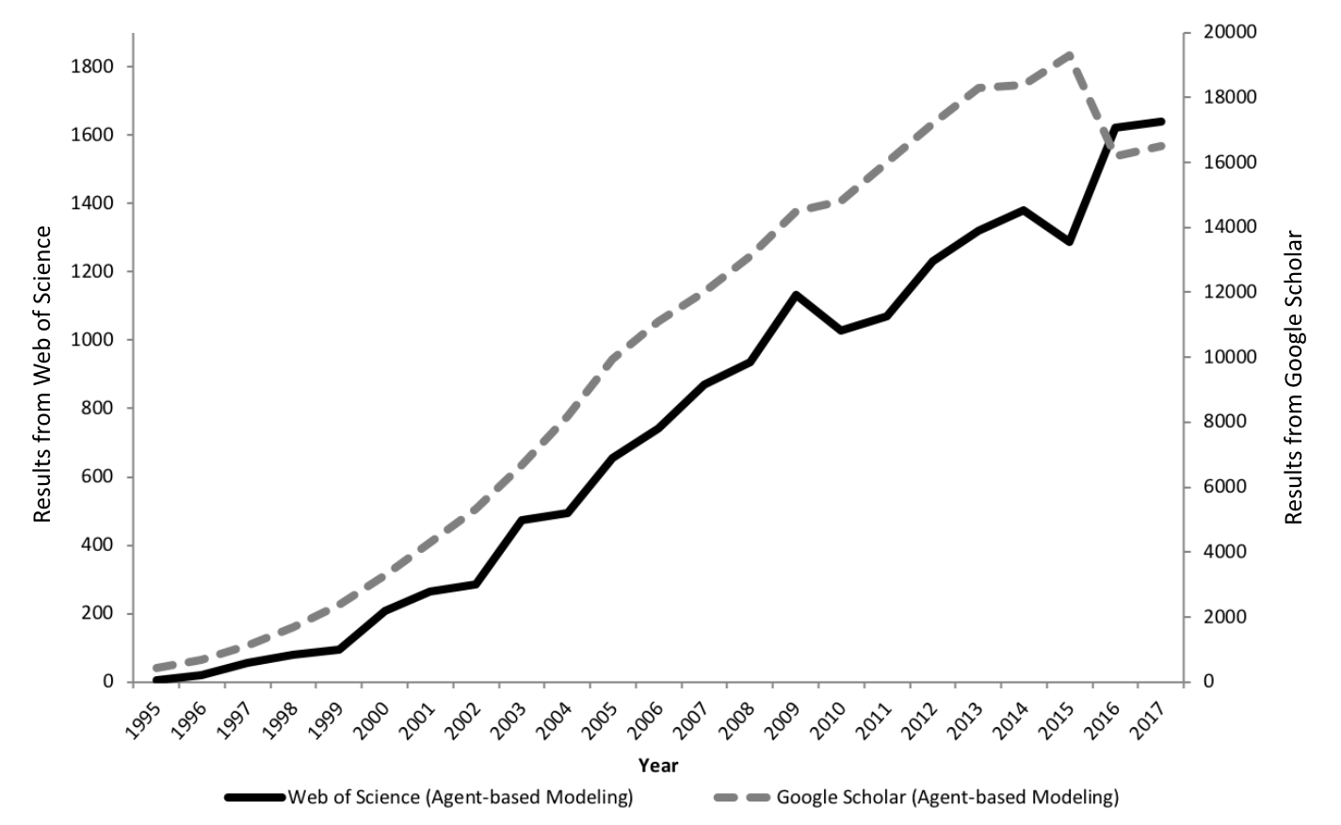
The Growth of Agent-based Modelling
Figure 2.4: The growth in agent-based modelling: from search results of Web of Science and Google Scholar.

Slide 10
Segregation
When we see patterns of segregated neighborhoods , the process that led to them has already happened.
What causes such patterns to emerge?
Schelling (1971) explored the idea of how mild tastes and preferences for like demographic groups could lead to patterns of segregation we observe in a abstract setting.
Simple model where agents check their surrounding cells (i.e. their neighbors) and sees if it is happy in the current location.
If the agent is not happy it moves to a new location.
Schelling, T. C. (1971). Dynamic models of segregation. Journal of Mathematical Sociology, 1(2), 143-186.

Slide 11
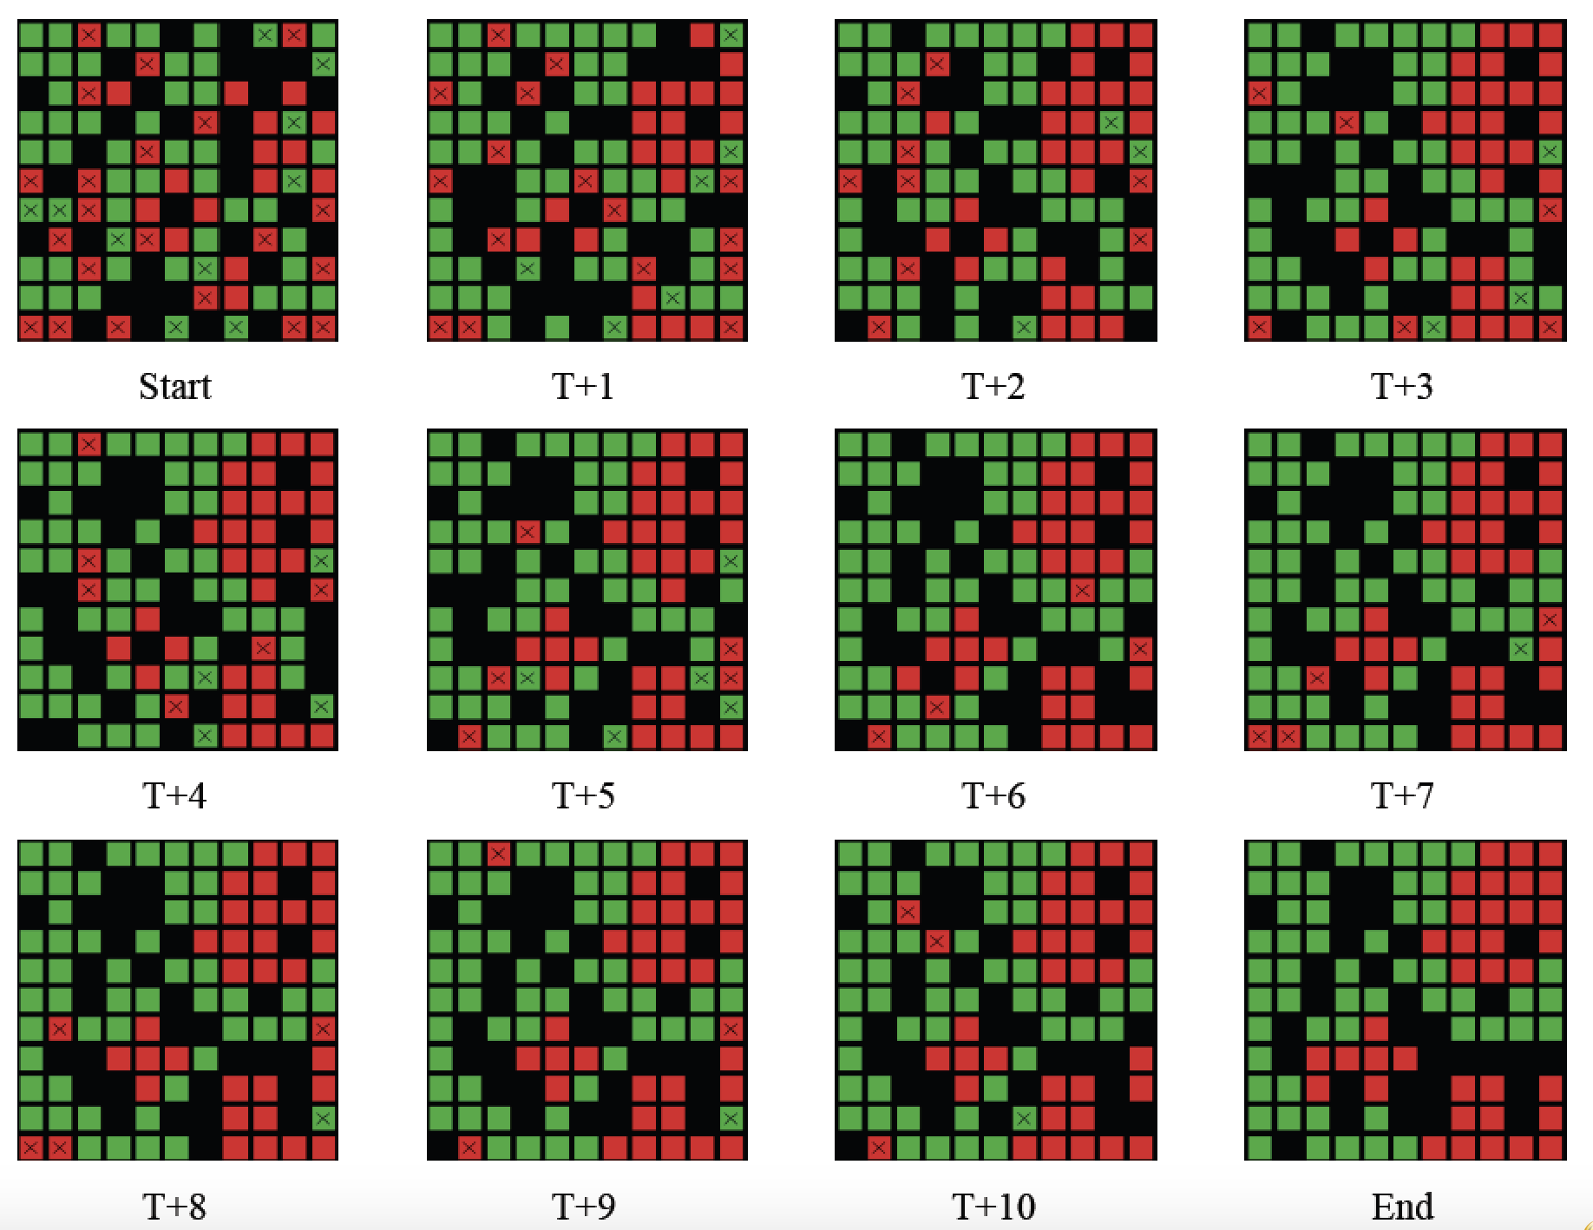
Progression of Segregation over Time
Figure 2.5: Progression of segregation over time: Agents what to live in a neighborhood where 40% are of the same color.

Slide 12
Changing Agents Preferences
Open up NetLogo’s Segregation Model
Once open, press the “setup” and then “go” buttons.
Watch how agents move to find neighborhoods they are satisfied with.
Change “%-similar-wanted” slider (which is the agents preference for neighborhood composition).
Press the “setup” and then “go” buttons.
Watch how agents move to find neighborhoods they are satisfied with.
Experiment with different values for “%-similar-wanted”
Is there at critical point were patterns of segregation become more distinct?

Slide 13
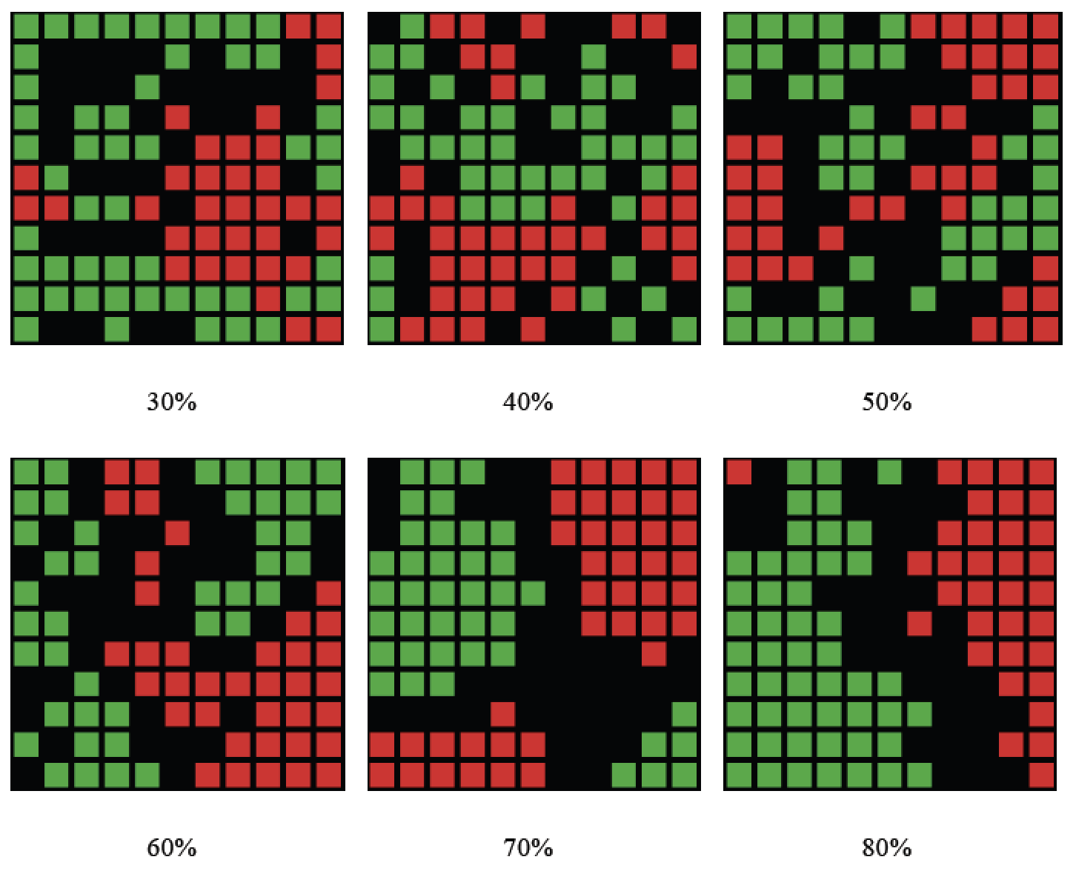
Changing Agents Preferences
Figure 2.6: Examples of how changing agents neighborhood preference levels leads to different patterns of segregation emerging.

Slide 14
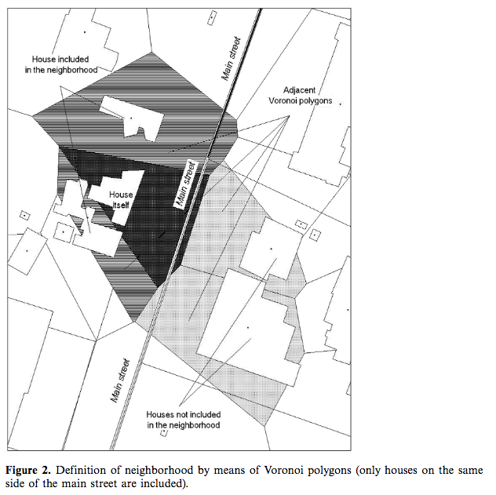
Segregation: From Abstract to Real World Application
Two factors are considered in calculating dissonance:
Agent-building dissonance:
E.G., Arab agents highly dislike modern blocks
Agent-neighbors dissonance:
Arab Christians don't mind living in neighborhoods predominantly populated by Arab Muslims,
But Jews and Muslims both dislike neighborhoods dominated by the other
Dissonance causes the agents to move or not
Source: I. Benenson, I. Omer, E. Hatna, 2002, “Entity-based modeling of urban residential dynamics - the case of Yaffo, Tel-Aviv.” Environment and Planning B, 29: 491-512.

Slide 15
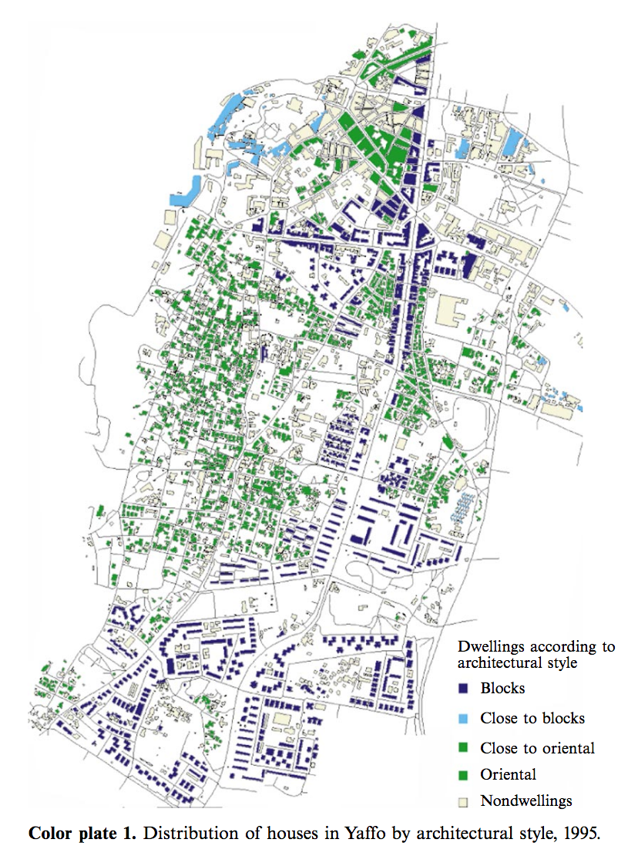
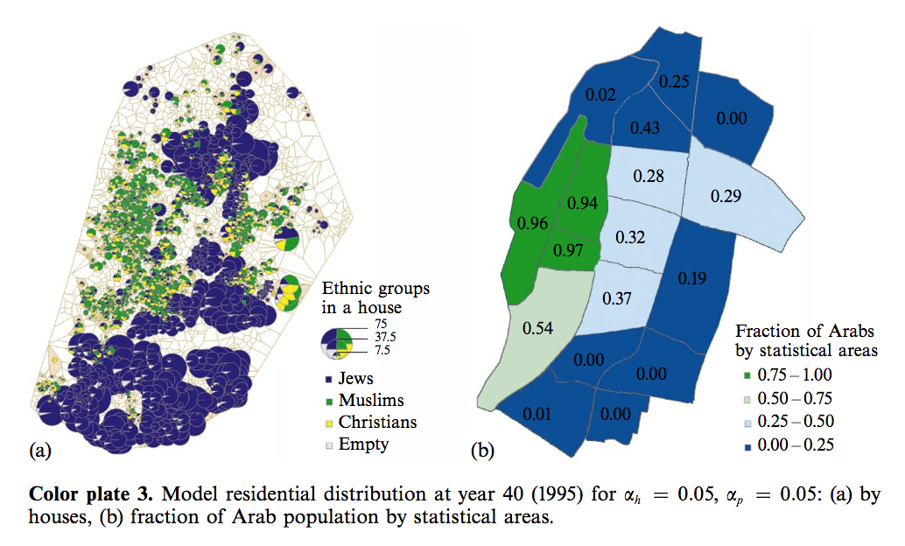
Segregation: From Abstract to Real World Application
Source: I. Benenson, I. Omer, E. Hatna, 2002, “Entity-based modeling of urban residential dynamics - the case of Yaffo, Tel-Aviv.” Environment and Planning B, 29: 491-512.

Slide 16
SugarScape
Agent-based models did not begin to feature prominently in the geographical literature until the mid-1990s.
This changed when Epstein and Axtell (1996) extended the notion of modelling people to growing entire artificial cities.
The goal was to understand the emergence of patterns, trends, and other characteristics observable in society or geography.
SugarScape that demonstrated that agents could emerge with a variety of characteristics and behaviors suggestive of a rudimentary society (e.g. death, disease, trade, health, culture, conflict, war).
Epstein, J.M. and Axtell, R. (1996) Growing Artificial Societies: Social Science from the Bottom Up. Cambridge, MA: MIT Press.

Slide 17
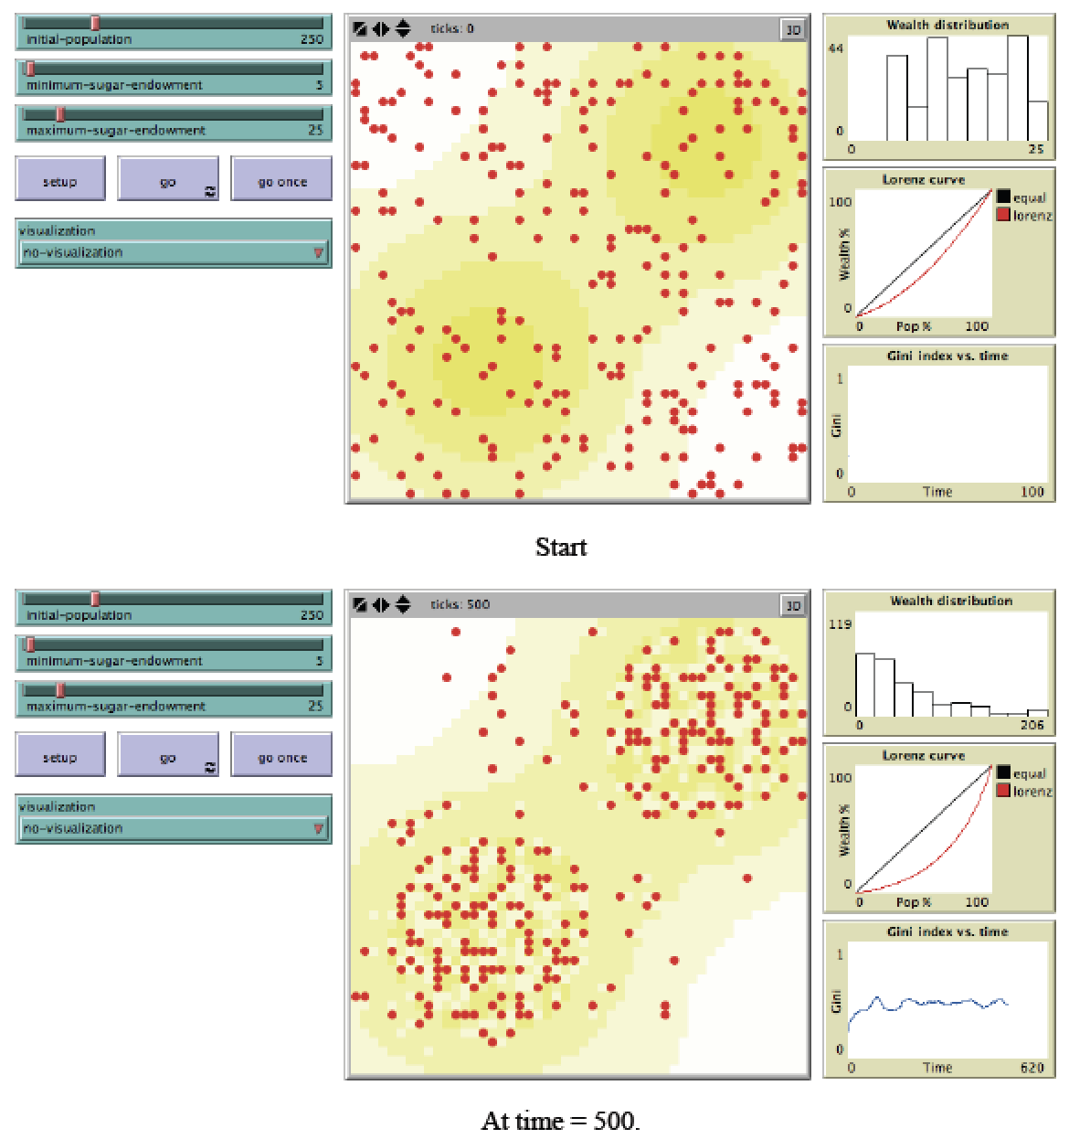
Graphical User Interface of Sugarscape Model
A terrain map is imported into the model and the values correspond to the amount of resources the cell has (i.e. the amount of sugar) which ranges from light to dark yellow
Initially agents are randomly distributed over the terrain, and assigned a certain amount of sugar, an age and a metabolic rate.
At each time step, an agent checks its surrounding cells and moves to an unoccupied cell with the highest amount of sugar), and eats all the sugar (and thus accumulates wealth).
An agent dies if it runs out of energy; otherwise it dies when it reaches a certain age.
Model demonstrates how through simple rules unequal distributions of wealth emerge.
Figure 2.7: Sugarscape wealth distribution model (Source: Li and Wilensky, 2009).
Notes:
Li, J. and Wilensky U. (2009) NetLogo Sugarscape 3 Wealth Distribution Model. http://ccl.northwestern.edu/netlogo/models/Sugar scape3WealthDistribution

Slide 18
Sugarscape Wealth Distribution Model
Open up SugarSape 3 Wealth Distribution Model.
http://ccl.northwestern.edu/netlogo/models/Sugar scape3WealthDistribution
The models has 3 adjustable parameters
initial-population (i.e. how many agents are in the model).
minimum-sugar-endowment (minimum amount of sugar i.e. wealth at the start).
maximum-sugar-endowment (maximum amount of sugar i.e. wealth at the start. Both endowments set the range of possible values).
Explore how different parameter settings impacts wealth distributions over time.

Slide 19
Transportation Modelling
Transportation is part of many people’s daily lives, and traffic congestion is the norm for many cities around the world
The cost of congestion is not only the time citizens spend in traffic jams, but also pollution and traffic accidents.
As the population of cities increases, an efficient transportation system is essential for urban futures.
Individual decisions are at the core of this issue
i.e. do I take the car or bus to work?.
Agent-based models are therefore ideal to explore such issues and to provide solutions.
Application areas range from exploring: stop-and-go traffic, traffic accidents, the impact of tolls, parking behavior, and evacuation.

Slide 20
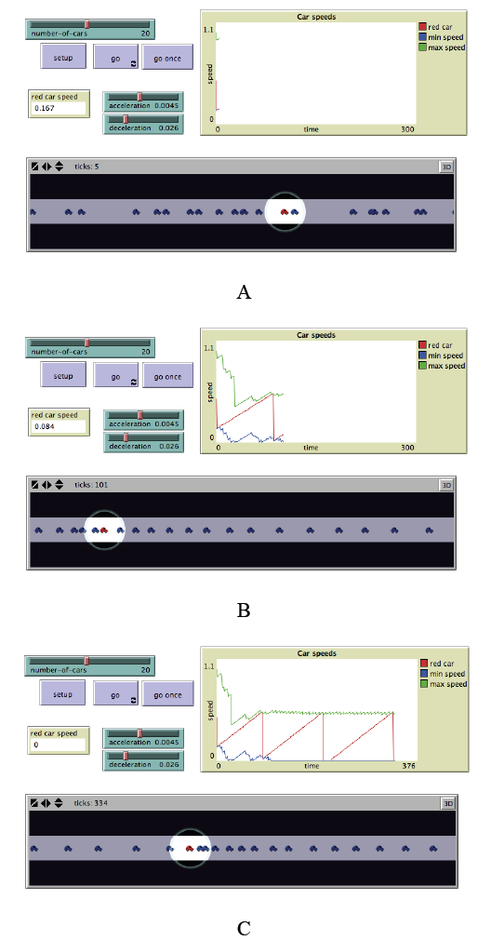
Traffic Modelling
Consider traffic jams that form in the opposite lane to a traffic accident, a consequence know as ‘rubber-necking’.
Simple Example:
Models the movement of cars on a road.
Each car follows a simple set of rules:
If there’s a car close ahead, it slows down.
If there’s no car ahead, it speeds up.
Demonstrates how traffic jams can form without any obvious incident.
Simple rules can explain complex phenomena.
Figure 2.8: Simple traffic model where each car is an agent. In A, B and C from top left clockwise, model parameters, a chart of car speeds and the spatial agent-environment (source: Wilensky, 1997).

Slide 21
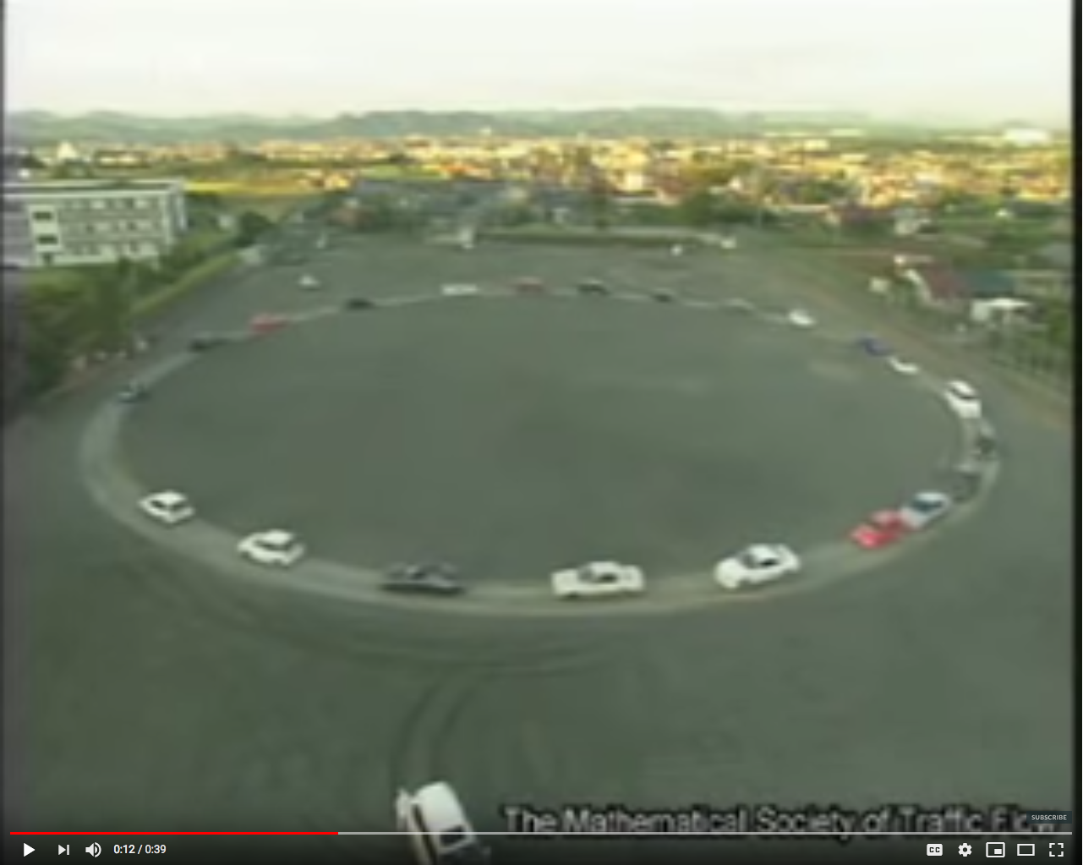
Shockwave Traffic Jam in Reality
22 cars equally spaced on a 230m single lane circle.
Drivers asked to cruise steadily at 30km/h.
1st traffic moved freely.
Disturbances/clusters soon appear.
Causing cars to slow/stop.
Cars at front of cluster can accelerate at 40km/h.
But these join another jam.
Source: http://www.youtube.com/watch?v=Suugn-p5C1M
Notes:
Click on image to see movie on YouTube. Simple real word example of how ideas in the (in previous slide) can be seen in the “real world”

Slide 22
Agent-based Models Used for Decision Making
Southwest Airlines used an agent-based model to improve how it handled cargo.
Eli Lilly used an agent-based model for drug development.
Pacific Gas and Electric: Used an agent based model to see how energy flows through the power grid.
Procter and Gamble used an agent-based model to understand its consumer markets.
NASDAQ used and agent based model to explore changes to Stock Market's decimalization.
Macy’s have used agent-based models for store design.
InSTREAM: Explores how river salmon populations react to changes in water conditions.

Slide 23
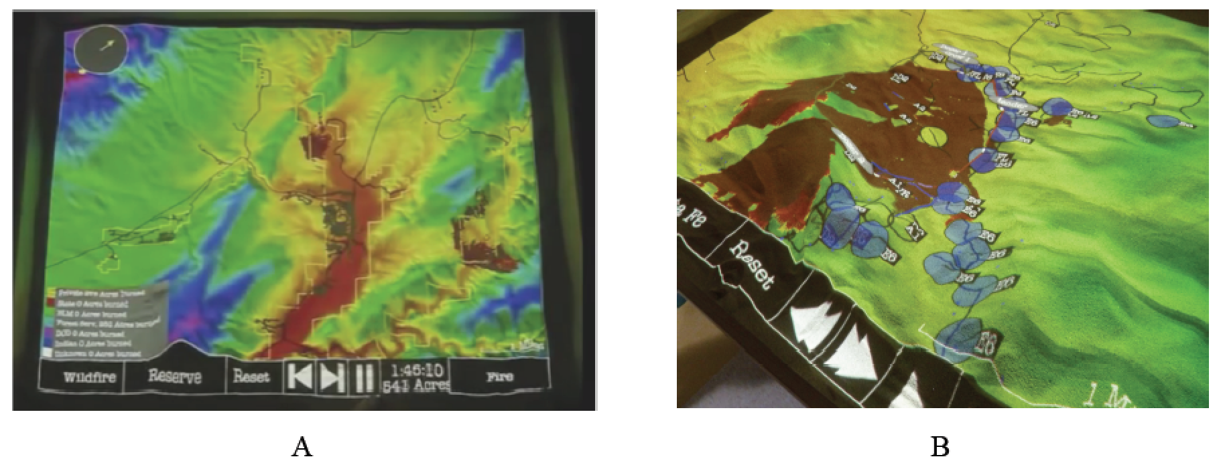
Real World Decision Making
Agent-based modeling has also been used for wild fire training, incident command and community outreach. For example SimTable was used in the 2016 Sand Fire in California.
Figure 2.9: User interface of SimTable: (A) Entire study area, (B): an active fire model (source: SimTable, 2017).
Notes:
Click on image to see a movie on YouTube. Or see https://youtu.be/aLmOxnPKUqk

Slide 24
Summary
Successfully replicating the processes and dynamics that occur within real-world geographical systems is highly challenging.
The notion of bottom-up modelling advocated by agent-based modelling allows the results of local phenomena to be understood and measured at an aggregate level.
Agent-based models allow every individual to be assigned their own characteristics.
This chapter has provided a general introduction to agent-based modelling. The main characteristics of agent-based modelling have been presented along with the advantages and limitations of this approach for geographical systems.
The chapter explored a diverse range of geographical applications of agent-based modelling

Slide 25
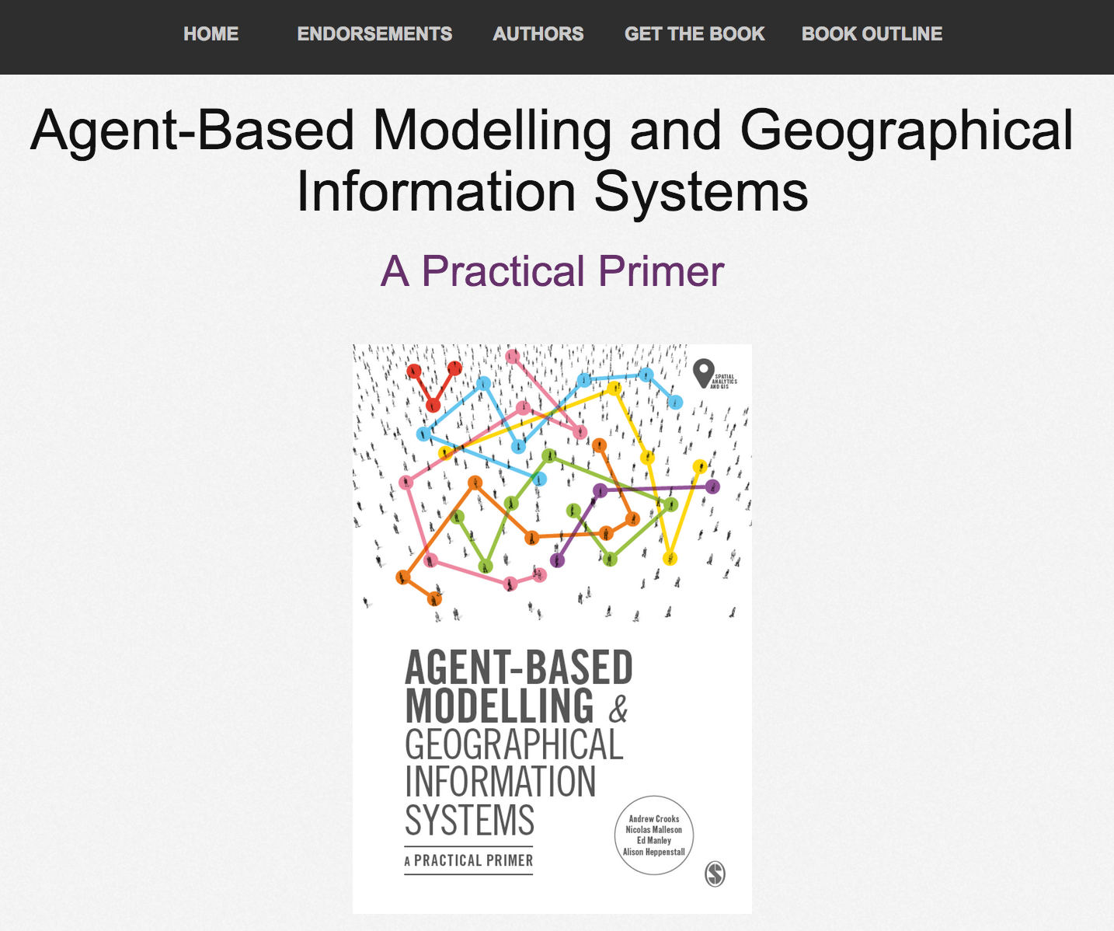
Online Resources
Visit: https://github.com/abmgis/abmgis/tree/master/Chapter02-IntroToABM for a selection of models to highlight core concepts introduced in this chapter

